Slide 1
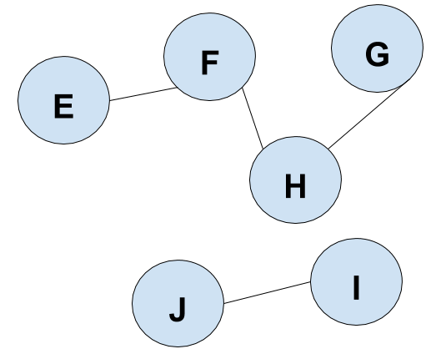
Scooby Doo Test Case 1 General graph representation
Edge List
EF GH IJ FH
Exists a path?
EG

Slide 2
Scooby Doo Test Case 1
Adjacency Matrix
 | A | B | C | D | E | F | G | H | I | J
A
B
C
D
E |  |  |  |  |  | 1
F |  |  |  |  | 1 |  |  | 1
G |  |  |  |  |  |  |  | 1
H |  |  |  |  |  | 1 | 1
I |  |  |  |  |  |  |  |  |  | 1
J |  |  |  |  |  |  |  |  | 1
Edge List
EF GH IJ FH
Exists a path?
EG
E
F
G
H
I
J

Slide 3
Scooby Doo Test Case 2
Edge List
AB CD EA FD BG FC
Exists a path?
AF
A
B
G
C
D
E
F

Slide 4
Scooby Doo Test Case 3
Edge List
RS TU VW TV WS
Exists a path?
JK
R
S
J
T
U
K
V
W

Slide 5
Scooby Doo Test Case 4
Edge List
XW XO PO CD DK CB BI QP TZ ZS TR RH HQ QR
Exists a path?
ZP
X
W
S
O
P
Q
T
Z
C
D
H
R
I
B
K

Slide 6
Scooby Doo Test Case 5
P
Q
R
Edge List
PQ PA AB CD MN QR NS NT BR BW BV SE EU UT
Exists a path?
AN
A
B
W
C
D
V
M
N
S
E
T
U

